Slide 1
6.4 Best Approximation; Least Squares

Slide 2
Theorem 6.4.1
Best Approximation Theorem
If W is a finite-dimensional subspace of an inner product space V, and if u is a vector in V, then proj_{W}u is the best approximation to u form W in the sense that
∥u- proj_{W}u ∥＜∥u-w∥
for every vector w in W that is different from proj_{W}u.

Slide 3
Theorem 6.4.2
For any linear system Ax=b, the associated normal system
A^{T}Ax=A^{T}b
is consistent, and all solutions of the normal system are least squares solutions of Ax=b. Moreover, if W is the column space of A, and x is any least squares solution of Ax=b, then the orthogonal projection of b on W is
proj_{W}b=Ax

Slide 4
Theorem 6.4.3
If A is an m×n matrix, then the following are equivalent.
A has linearly independent column vectors.
A^{T}A is invertible.

Slide 5
Theorem 6.4.4
If A is an m×n matrix with linearly independent column vectors, then for every m×1 matrix b, the linear system Ax=b has a unique least squares solution. This solution is given by
x=(A^{T}A)⁻¹ A^{T}b (4)
Moreover, if W is the column space of A, then the orthogonal projection of b on W is
proj_{W}b=Ax=A(A^{T}A)⁻¹ A^{T}b (5)

Slide 6
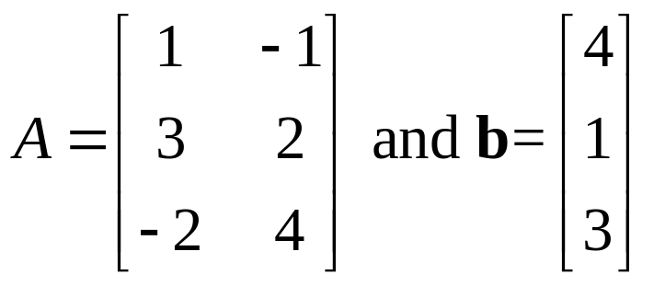
Example 1
Least Squares Solution (1/3)
Find the least squares solution of the linear system Ax=b given by
x₁- x₂=4
3x₁+2x₂=1
-2x₁+4x₂=3
and find the orthogonal projection of b on the column space of A.
Solution.
Here

Slide 7
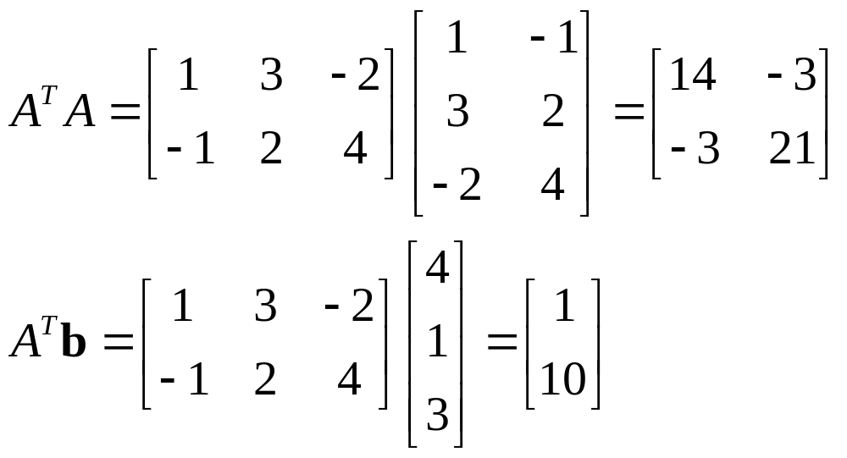
Example 1
Least Squares Solution (2/3)
Observe that A has linearly independent column vectors, so we know in advance that there is a unique least squares solution. We have

Slide 8
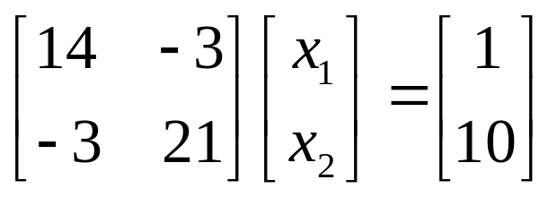
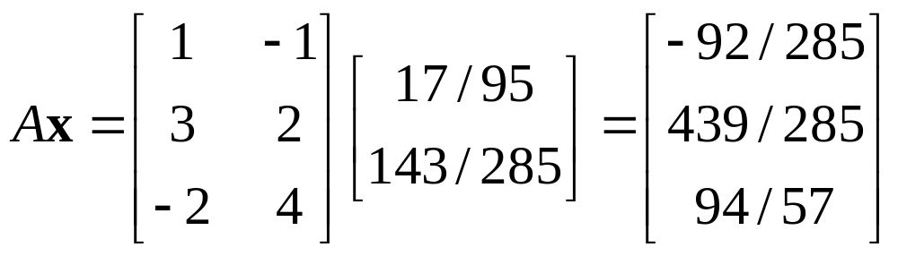
Example 1
Least Squares Solution (3/3)
so the normal system A^{T}Ax=A^{T}b in this case is
Solving this system yields the least squares solution x₁=17/95, x₂=143/285
From (5), the orthogonal projection of b on the column space of A is

Slide 9
Example 2
Orthogonal Projection on a Subspace (1/4)
Find the orthogonal projection of the vector u=(-3, -3, 8, 9) on the subspace of R⁴ spanned by the vectors
u₁=(3, 1, 0, 1), u₂=(1, 2, 1, 1), u₃=(-1, 0, 2, -1)
Solution.
One could solve this problem by first using the Gram-Schmidt process to convert {u₁, u₂, u₃} into an orthonormal basis, and then applying the method used in Example 6 of Section 6.3. However, the following method is more efficient.

Slide 10

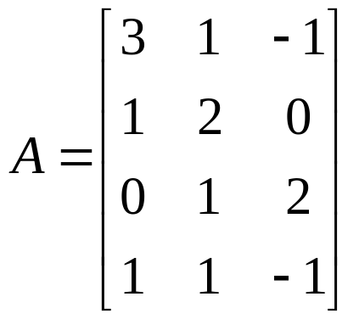
Example 2
Orthogonal Projection on a Subspace (2/4)
The subspace W of R⁴ spanned by u₁, u₂, and u₃ is the column space of the matrix
Thus, if u is expressed as a column vectors, we can find the orthogonal projection of u on W by finding a least squares solution of the system Ax=u and then calculating proj_{W}u=Ax from the least squares solution. The computations are as following: The system Ax=u is

Slide 11
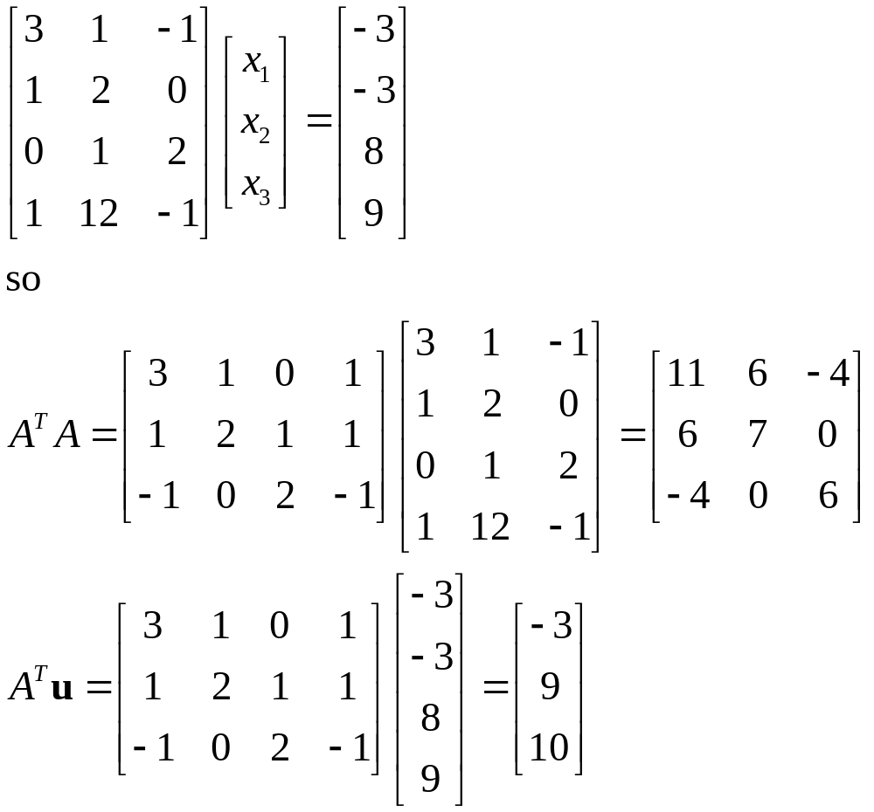
Example 2
Orthogonal Projection on a Subspace (3/4)

Slide 12
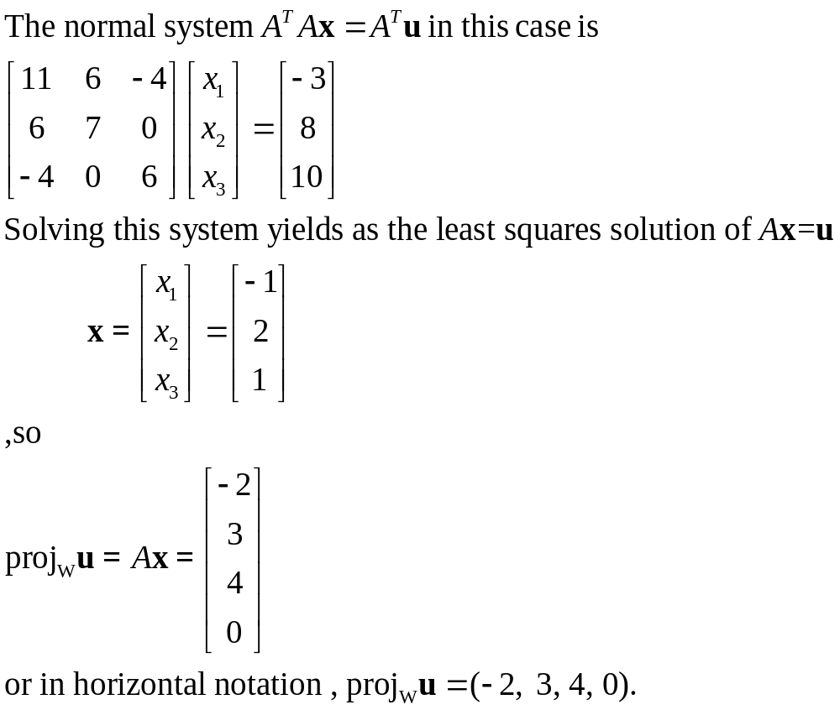
Example 2
Orthogonal Projection on a Subspace (4/4)

Slide 13
Definition
If W is a subspace of R^{m}, then the transformation P: R^{m} → W that maps each vector x in R^{m} into its orthogonal projection proj_{W}x in W is called orthogonal projection of R^{m} on W.

Slide 14
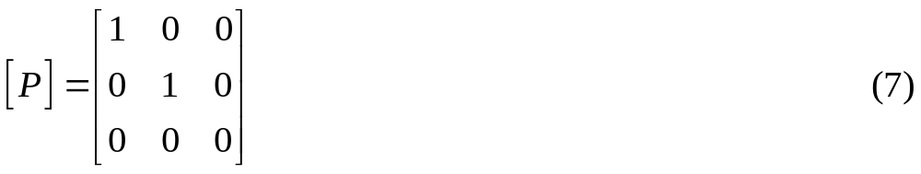
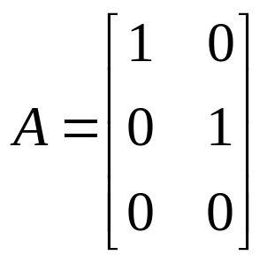
Example 3
Verifying Formula [6] (1/2)
In Table 5 of Section 4.2 we showed that the standard matrix for the orthogonal projection of R³ on the xy-plane is
To see that is consistent with Formula (6), take the unit vectors along the positive x and y axes as a basis for the xy-plane, so that

Slide 15
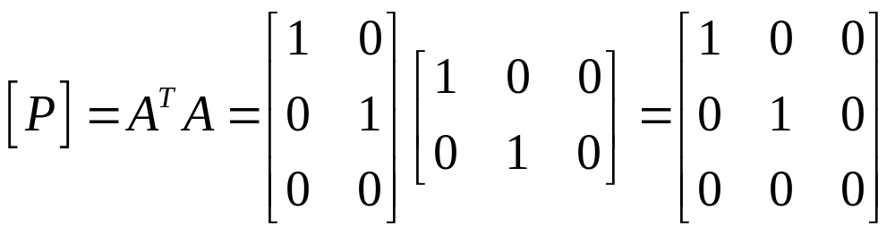
Example 3
Verifying Formula [6] (2/2)
We leave it for the reader to verify that A^{T}A is the 2×2 identity matrix; thus, (6) simplifies to
which agrees with (7).

Slide 16
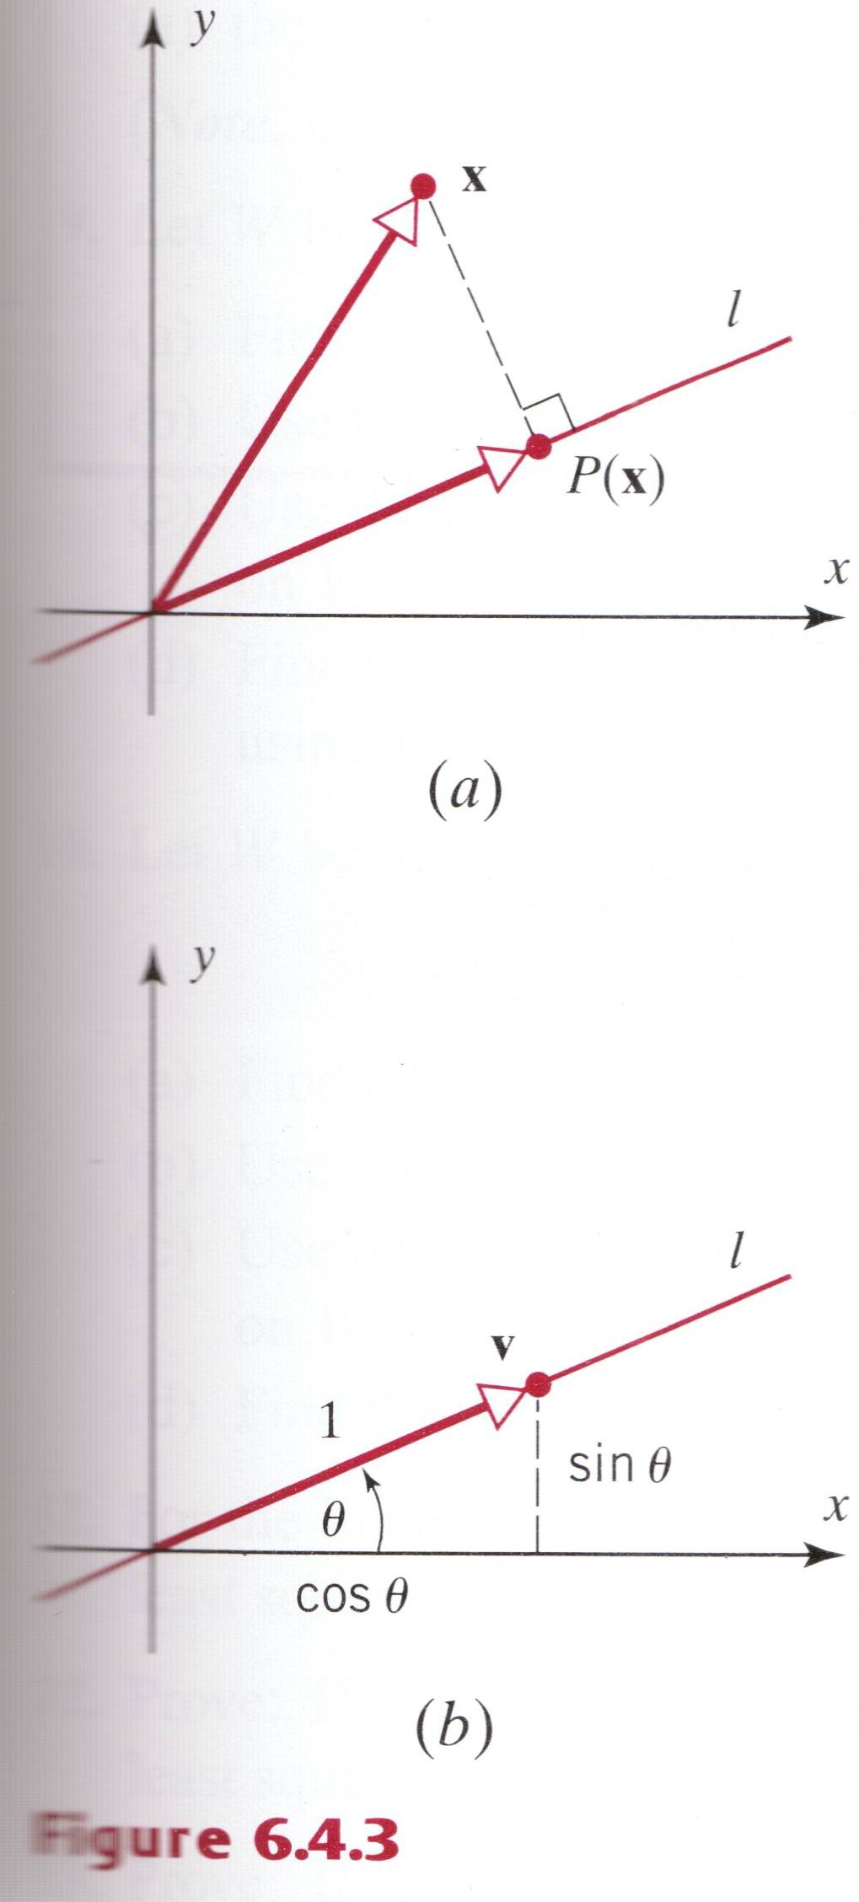
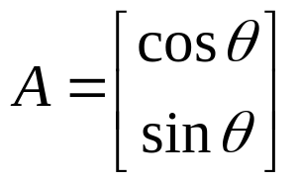
Example 4
Standard Matrix for an Orthogonal Projection (1/2)
Find the standard matrix for the orthogonal projection P of R² on the line l that passes through the origin and makes an angle θ with the positive x-axis.
Solution.
The line l is a one-dimensional subspace of R². As illustrated in Figure 6.4.3, we can take v=(cosθ, sinθ) as a basis for this subspace, so

Slide 17
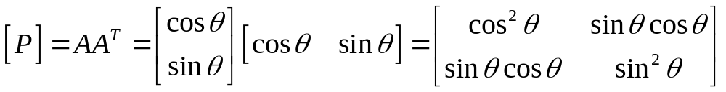
Example 4
Standard Matrix for an Orthogonal Projection (2/2)
We leave it for the reader to show that A^{T}A is the 1×1 identify matrix; thus, Formula (6) simplifies to
Note that this agrees with Example 6 of Section 4.3.

Slide 18
Theorem 6.4.5
Equivalent Statements (1/2)
If A is an n×n matrix, and if T_{A}: R_{n} → R_{n} is multiplication by A, then the following are equivalent.
A is invertible.
Ax=0 has only the trivial solution.
The reduced row-echelon form of A is I_{n}.
A is expressible as a product of elementary matrices.
Ax=b is consistent for every n×1 matrix b.
Ax=b has exactly one solution for every n×1 matrix b.
det(A)≠0.
The range of T_{A} is R^{n}.

Slide 19
Theorem 6.4.5
Equivalent Statements (2/2)
T_{A} is one-to-one.
The column vectors of A are linearly independent.
The row vectors of A are linearly independent.
The column vectors of A span R^{n}.
The row vectors of A span R^{n}.
The column vectors of A form a basis for R^{n}.
The row vectors of A form a basis for R^{n}.
A has rank n.
A has nullity 0.
The orthogonal complement of the nullspace of A is R^{n}.
The orthogonal complement of the row space of A is {0}.
A^{T}A is invertible.

Slide 20
6.5 Orthogonal Matrices: Change of Basis

Slide 21
Definition
A square matrix A with the property
A⁻¹=A^{T}
is said to be an orthogonal matrix.

Slide 22
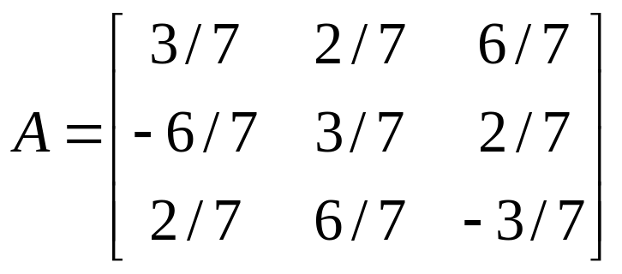
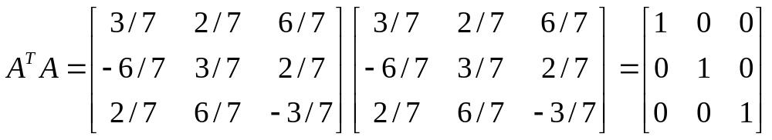
Example 1
A 3×3 Orthogonal Matrix
The matrix
is orthogonal, since

Slide 23
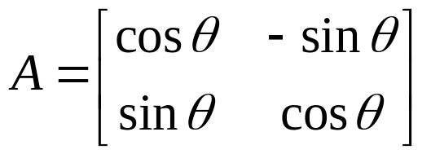
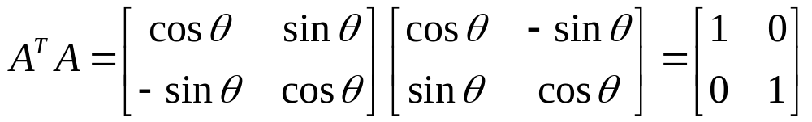
Example 2
A Rotation Matrix Is Orthogonal
Recall form Table 6 of Section 4.2 that the standard matrix for the counterclockwise rotation of R² through an angle θ is
This matrix is orthogonal for all choices of θ, since
In fact, it is a simple matter to check that all of the “reflection matrices” in Table 2 and 3 all of the “rotation matrices” in Table 6 and 7 of Section 4.2 are orthogonal matrices.

Slide 24
Theorem 6.5.1
The following are equivalent for an n×n matrix A.
A is orthogonal.
The row vectors of A form an orthonormal set in R^{n} with the Euclidean inner product.
The column vectors of A form an orthonormal set in R^{n} with the Euclidean inner product.

Slide 25
Theorem 6.5.2
The inverse of an orthogonal matrix is orthogonal.
A product of orthogonal matrices is orthogonal.
If A is orthogonal, then det(A)=1 or det(A)=-1.

Slide 26
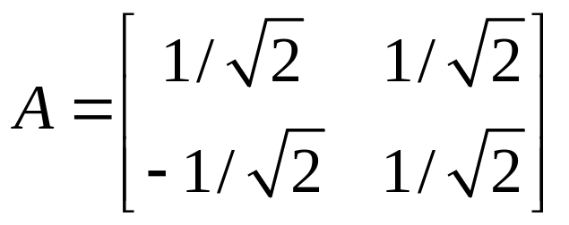
Example 3 det[A]=±1 for an Orthogonal Matrix A
The matrix
is orthogonal since its row (and column) vectors form orthonormal sets in R². We leave it for the reader to check that det(A)=1. Interchanging the rows produces an orthogonal matrix for which det(A)=-1.

Slide 27
Theorem 6.5.3
If A is an n×n matrix, then the following are equivalent.
A is orthogonal.
∥Ax∥=∥x∥ for all x in R^{n}.
Ax‧Ay=x‧y for all x and y in R^{n}.

Slide 28
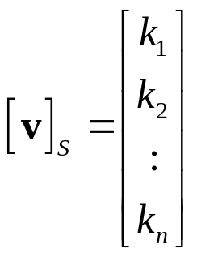
Coordinate Matrices
Recall from Theorem 5.4.1 that if S={v₁, v₂, .., v_{n}} is a basis for a vector space V, then each vector v in V can be expressed uniquely as a linear combination of the basis vectors, say
v=k₁v₁+k₂v₂+…+k_{n}v_{n}
The scalars k₁, k₂, …, k_{n} are the coordinates of v relative to S, and the vector
(v)_{s}=(k₁, k₂, …, k_{n})
is the coordinate vector of v relative to S. In this section it will be convenient to list the coordinates as entries of an n×1 matrix. Thus, we define
to be the coordinate matrix of v relative to S.

Slide 29
Change of Basis Problem
If we change the basis for a vector space V from some old basis B to some new basis B’, how is the old coordinate matrix [v]_{B} of a vector v related to the new coordinate matrix [v]_{B’}?

Slide 30
Solution of the Change of Basis Problem
If we change the basis for a vector space V from some old basis B={u₁, u₂, …, u_{n}} to some new basis B’ ={u₁’, u₂’, …, u_{n}’}, then the old coordinate matrix [v]_{B} of a vector v is related to the new coordinate matrix [v]_{B’} of the same vector v by the equation
[v]_{B}=P[v]_{B’} (7)
where the column of P are the coordinate matrices of the new basis vectors relative to the old basis; that is, the column vectors of P are
[v₁’]_{B}, [v₂’]_{B}, …, [v_{n}’]_{B}

Slide 31
Transition Matrices
The matrix P is called the transition matrix form B’ to B; it can be expressed in terms of its column vector as
P=[[u₁’]_{B} | [u₂’]_{B} | …| [u_{n}’]_{B}] (8)

Slide 32
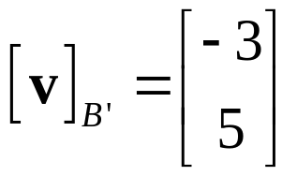
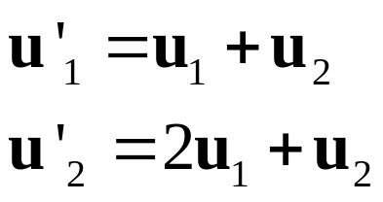
Example 4
Finding a Transition Matrix (1/2)
Consider bases B={u₁, u₂} and B’={u₁’, u₂’} for R², where u₁=(1, 0); u₂=(0, 1); u₁’=(1, 1); u₂’=(2, 1)
Find the transition matrix from B’ to B.
Use [v]_{B}=P[v]_{B’} to find [v]_{B} if
Solution (a). First we must find the coordinate matrices for the new basis vectors u₁’ and u₂’ relative to the old basis B. By inspection

Slide 33
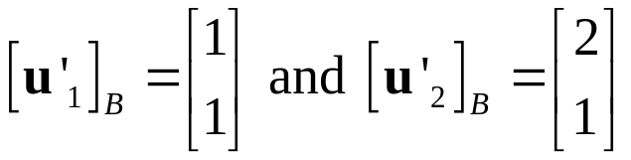
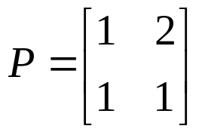
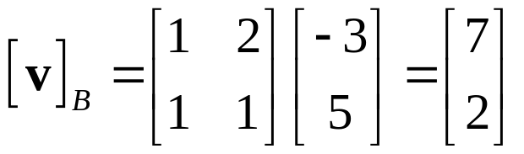
Example 4
Finding a Transition Matrix (2/2)
so that
Thus, the transition matrix from B’ to B is
Solution (b). Using [v]_{B}=P[v]_{B’} and the transition matrix in part (a),
As a check, we should be able to recover the vector v either from [v]_{B} or [v]_{B’}. We leave it for the reader to show that -3u₁’+5u₂’=7u₁+2u₂=v=(7, 2).

Slide 34
Example 5
A Different Viewpoint on Example 4 (1/2)
Consider the vectors u₁=(1, 0), u₂=(0, 1), u₁’=(1, 1), u₂’=(2, 1). In Example 4 we found the transition matrix from the basis B’={u₁’, u₂’} for R² to the basis B={u₁, u₂}. However, we can just as well ask for the transition matrix from B to B’. To obtain this matrix, we simply change our point of view and regard B’ as the old basis and B as the new basis. As usual, the columns of the transition matrix will be the coordinates of the new basis vectors relative to the old basis.
By equating corresponding components and solving the resulting linear system, the reader should be able to show that

Slide 35
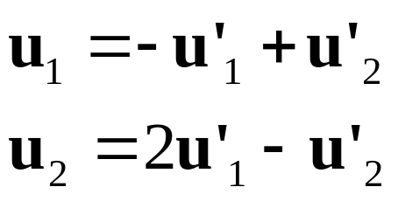
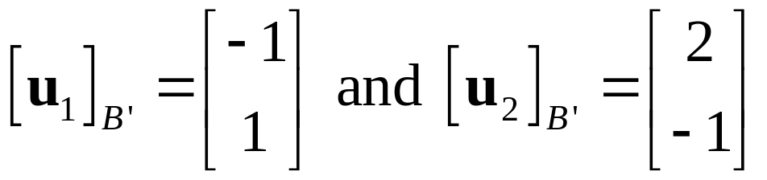
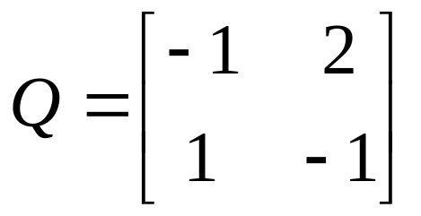
Example 5
A Different Viewpoint on Example 4 (2/2)
so that
Thus, the transition matrix from B to B’ is

Slide 36
Theorem 6.5.4
If P is the transition matrix from a basis B’ to a basis B for a finite-dimensional vector space V, then:
P is invertible.
P⁻¹ is the transition matrix from B to B’.

Slide 37
Theorem 6.5.5
If P is the transition matrix from one orthonormal basis to another orthonormal basis for an inner product space, then P is an orthogonal matrix; that is,
P⁻¹=P^{T}

Slide 38
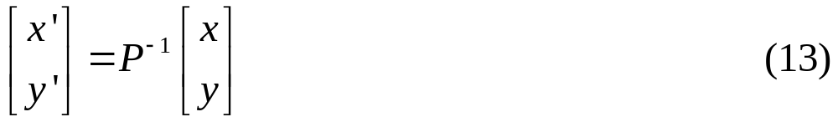
Example 6
Application to Rotation of Axes in 2-Space (1/5)
In many problems a rectangular xy-coordinate system is given and a new x’y’-coordinate system is obtained by rotating the xy-system counterclockwise about the origin through an angle θ. When this is done, each point Q in the plane has two sets of coordinates: coordinates (x, y) relative to the xy-system and coordinates (x’, y’) relative to the x’y’-system (Figure 6.5.1a).
By introducing vectors u₁ and u₂ along the positive x and y axes and unit vectors u’₁ and u’₂ along the positive x’ and y’ axes, we can regard this rotation as a change from an old basis B={u₁, u₂} to a new basis B’={u₁’, u₂’} (Figure 6.5.1b). Thus, the new coordinates (x’, y’) and the old coordinates (x, y) of a point Q will be related by

Slide 39
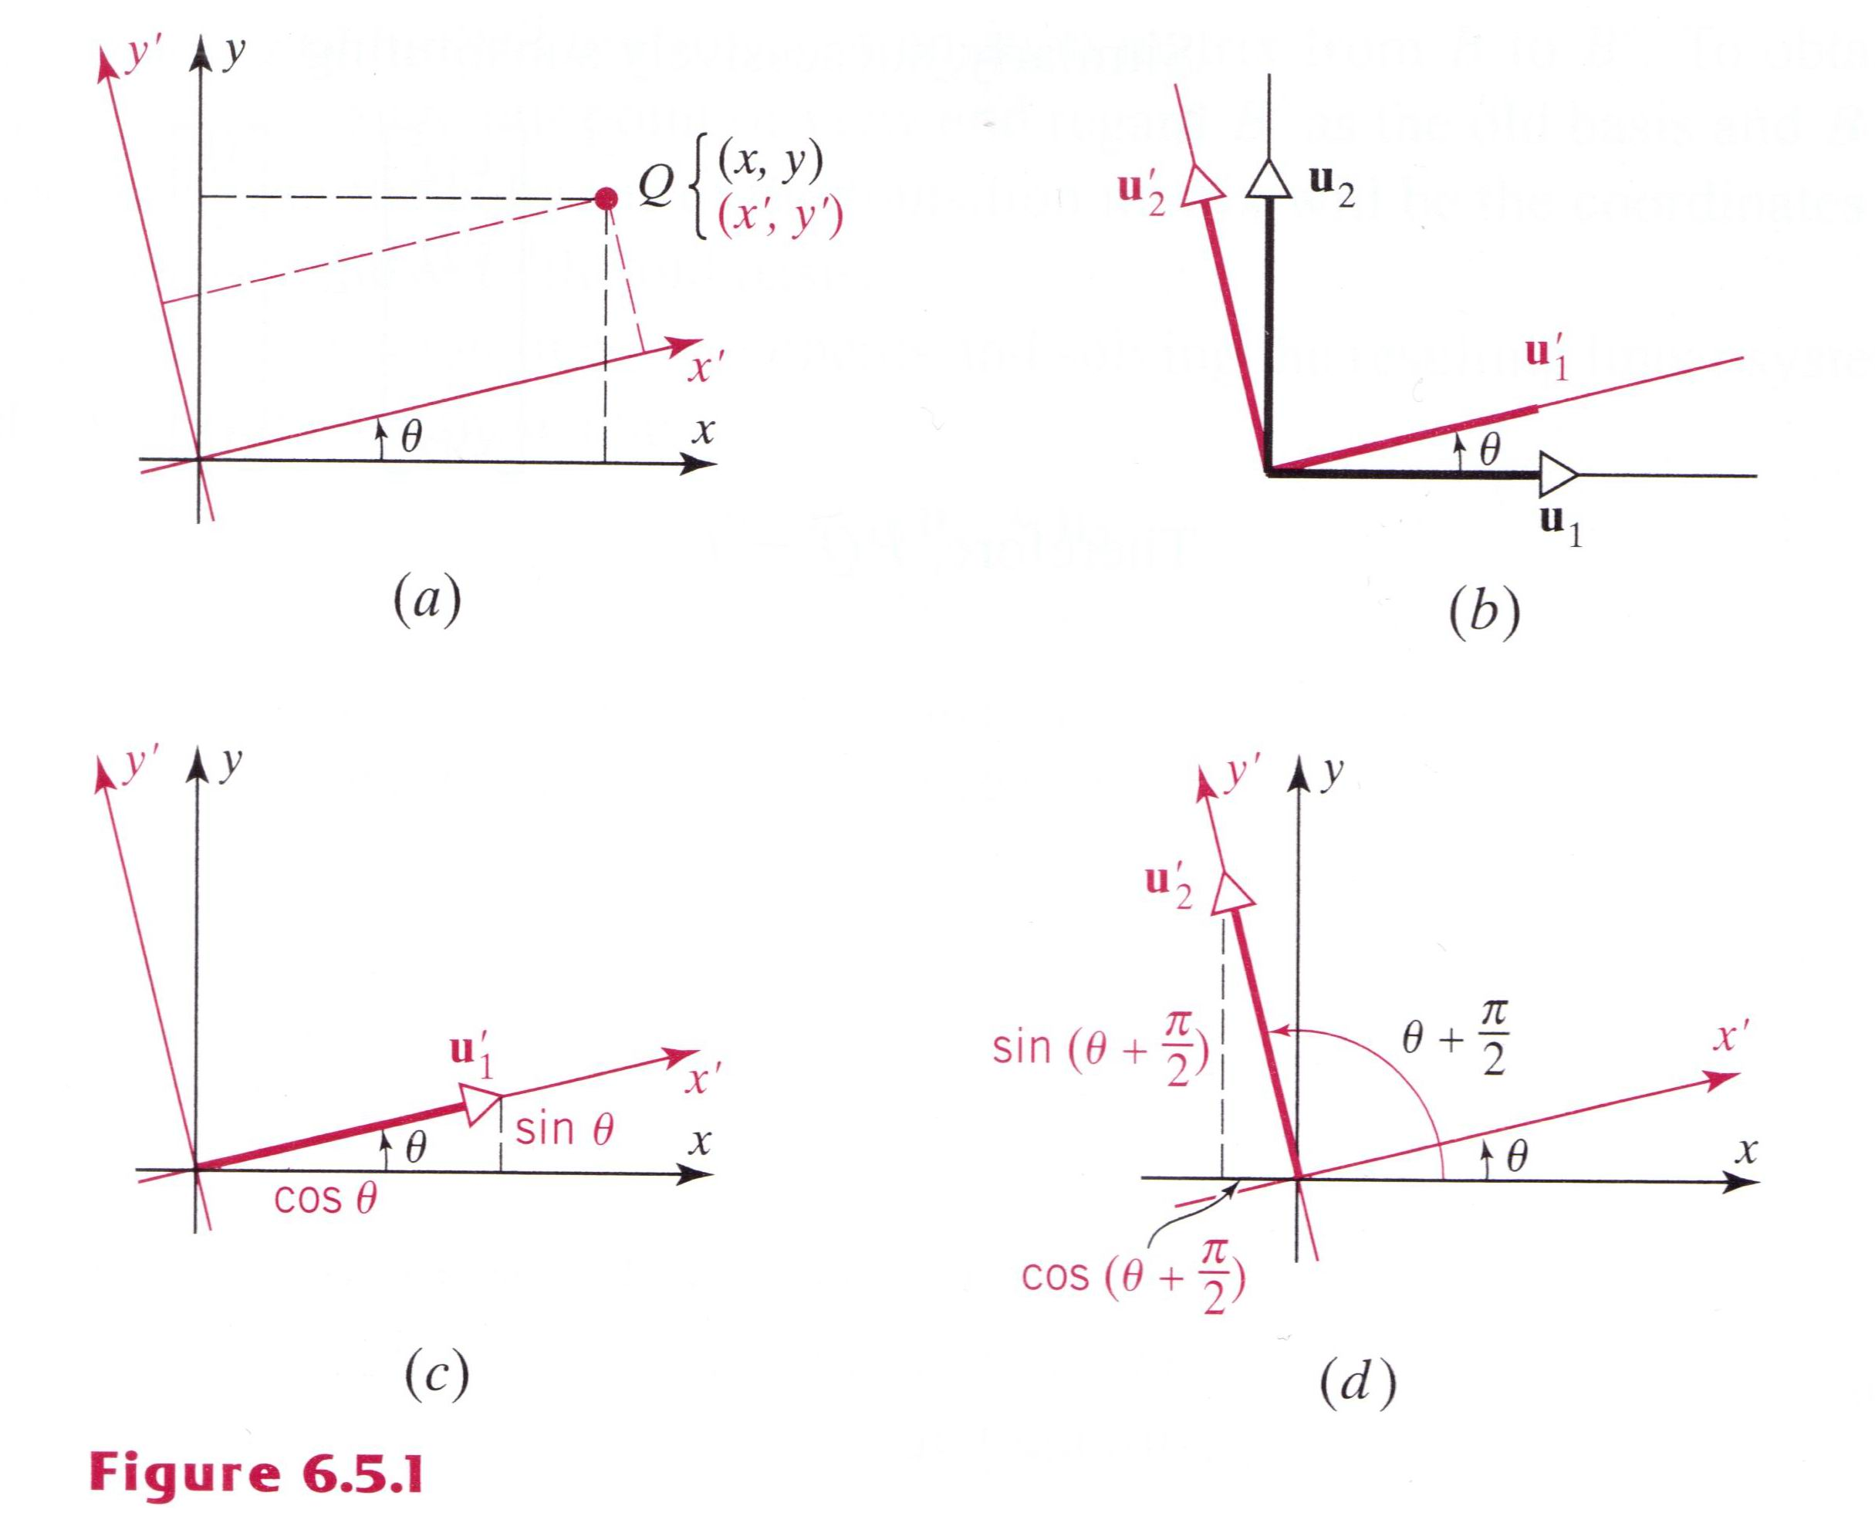
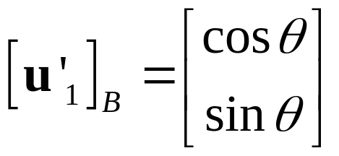
Example 6
Application to Rotation of Axes in 2-Space (2/5)
where P is transition from B’ to B. To find P we must determine the coordinate matrices of the new basis vectors u₁’ and u₂’ relative to the old basis. As indicated in Figure 6.5.1c, the components of u₁’ in the old basis are cosθ and sinθ so that

Slide 40
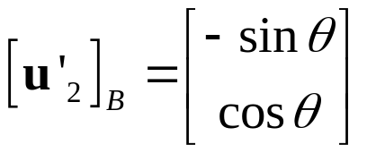
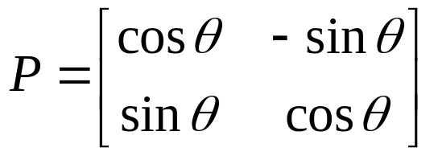
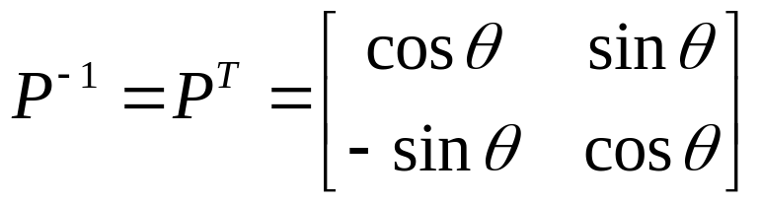
Example 6
Application to Rotation of Axes in 2-Space (3/5)
Similarly, from Figure 6.5.1d, we see that the components of u₂’ in the old basis are cos(θ＋π/2)=-sinθ and sin(θ＋π/2)=cosθ, so that
Thus, the transition matrix from B’ to B is
Observe that P is an orthogonal matrix, as expected, since B and B’ are orthonormal bases. Thus,

Slide 41
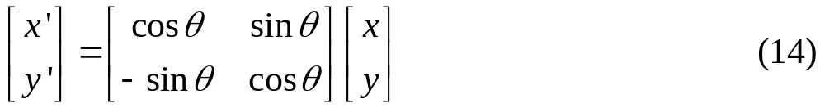
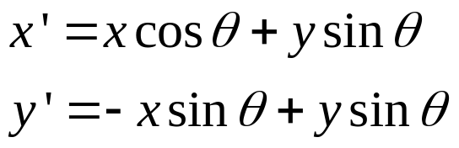
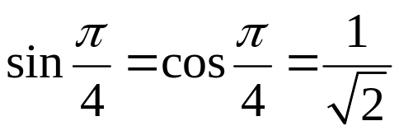
Example 6
Application to Rotation of Axes in 2-Space (4/5)
so (13) yields
or equivalently,
For example, if the axes are rotated θ=π/4, then since
Equation (14) becomes

Slide 42
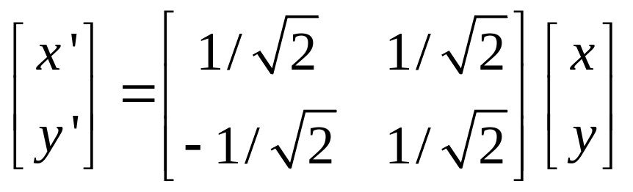
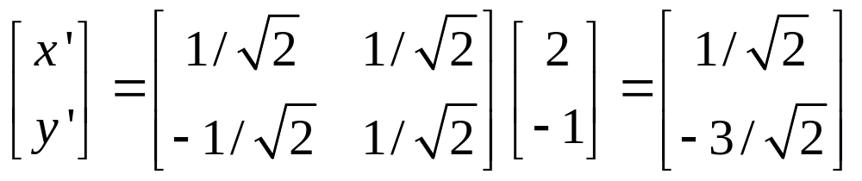
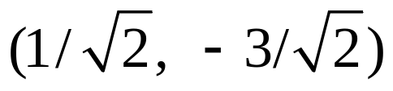
Example 6
Application to Rotation of Axes in 2-Space (5/5)
Thus, if the old coordinates of a point Q are (x, y)=(2, -1), then
so the new coordinates of Q are (x’, y’)= .

Slide 43
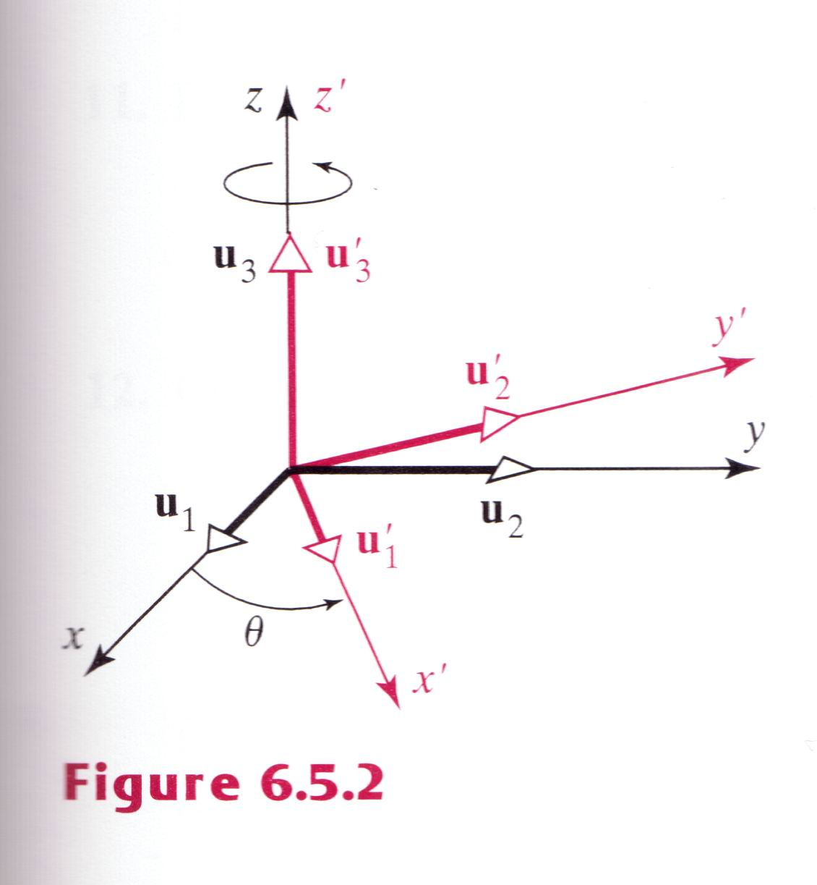
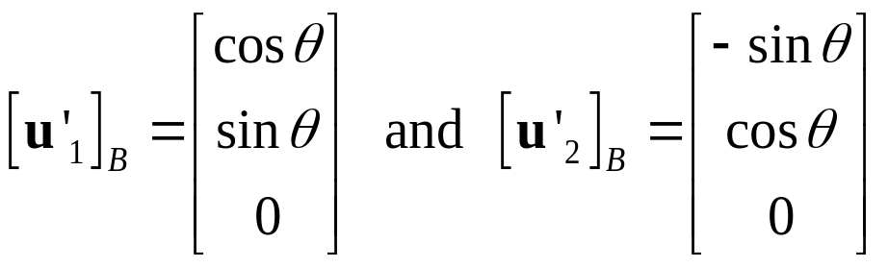
Example 7
Application to Rotation of Axes in 3-Space (1/3)
Suppose that a rectangular xyz-coordinate system is rotated around its z-axis counterclockwise (looking down the positive z-axis) through an angle θ (Figure 6.5.2). If we introduce unit vector u₁, u₂, and u₃ along the positive x, y, and z axes and unit vectors u’₁, u’₂, and u’₃ along the positive x’, y’, and z’ axes, we can regard the rotation as a change from the old basis B={u₁, u₂, u₃} to the new basis B’={u₁’, u₂’, u₃’}. In light of Example 6 it should be evident that

Slide 44
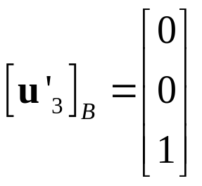
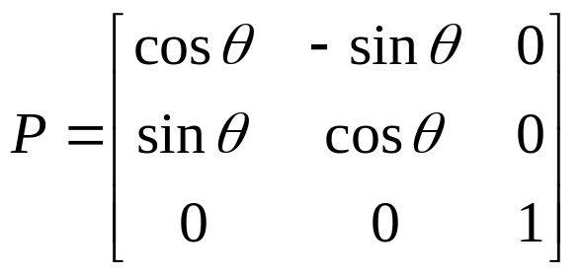
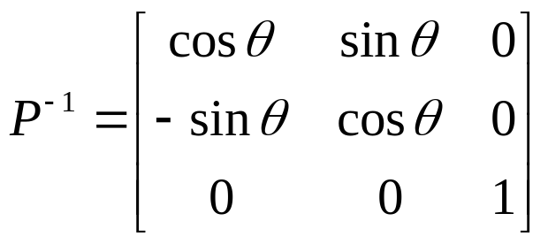
Example 7
Application to Rotation of Axes in 3-Space (2/3)
Moreover, since u₃’ extends 1 unit up the positive z’-axis,
Thus, the transition matrix form B’ to B is
and the transition matrix form B to B’ is

Slide 45
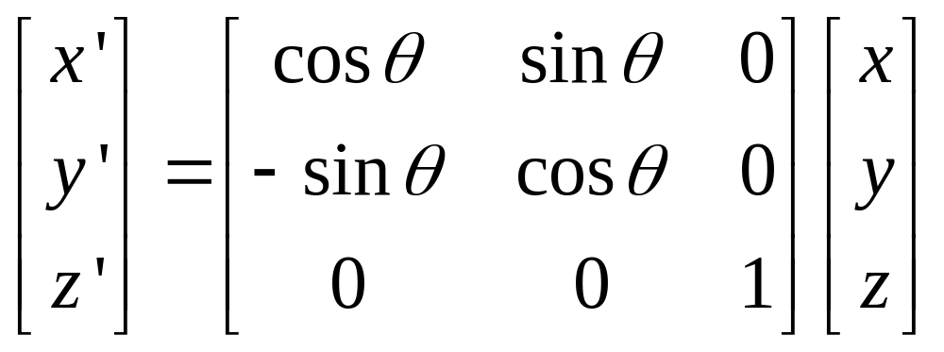
Example 7
Application to Rotation of Axes in 3-Space (3/3)
Thus, the new coordinates (x’, y’, z’) of a point Q can be computed from its old coordinates (x, y, z) by

